Slide 1
[W065RP11(12-16)P]
[Transformer induced PCB vibration & audible noise noise]
Corrective Action Report

Slide 2
˙Content
Issue Description
RMA Sample Verification
Root Cause Analysis
Corrective Action
Improve Sample Verification
Preventive Action

Slide 3
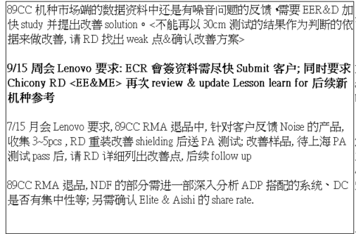
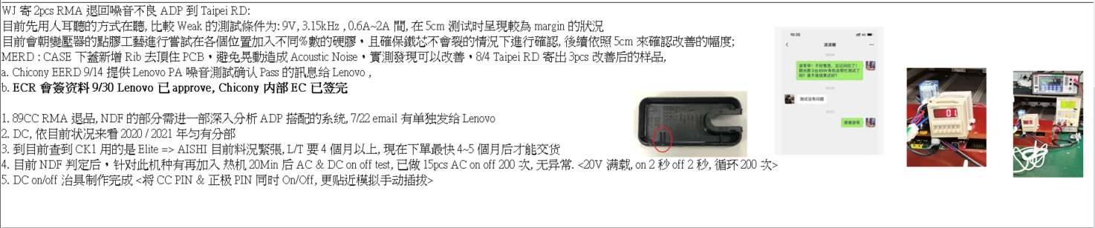
˙Issue Description

Slide 4
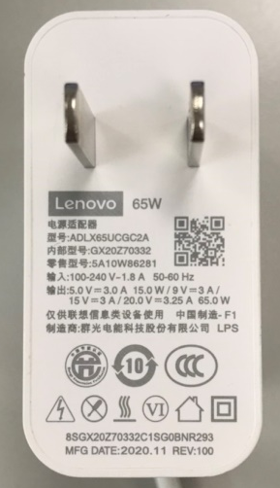
˙RMA Sample Verification_ Step Load
RMA樣機測試 Step load條件，樣機於20V輸出時，負載 0~1A項目雖可符合規格，但僅margin pass 規格，較差噪音情況集中在輕載條件
Output | Load Change | 90V/50Hz |  |  |  | 115V/50Hz |  |  |  | 230V/60Hz |  |  |  | 265V/60Hz |  |  |  | RMA SAMPLE
 |  | Total | 8kHz | 10kHz | 12.5kHz | Total | 8kHz | 10kHz | 12.5kHz | Total | 8kHz | 10kHz | 12.5kHz | Total | 8kHz | 10kHz | 12.5kHz
+5V mode 1KHz | 0 to 0.75A | 12.1 | 2.6 | 3.1 | 2.5 | 10.2 | -0.1 | -5.9 | -2.3 | 11.4 | 2.0 | -2.7 | -0.2 | 11.6 | 0.2 | 1.2 | 0.6
 | 0.75 to 1.5A | 12.5 | 3.3 | -4.2 | -3.5 | 13.3 | 3.6 | -3.9 | -1.8 | 12.2 | 3.2 | -2.1 | 1.2 | 14.6 | 3.6 | -2.4 | 3.4
 | 1.5 to 2.25A | 8.6 | -2.2 | -5.4 | -5.9 | 9.1 | -0.8 | -6.3 | -6.8 | 10.9 | 0.7 | -3.2 | -6.1 | 13.0 | 3.5 | -0.8 | -1.3
 | 2.25 to 3A | 7.8 | -4.0 | -6.0 | -5.7 | 8.3 | -3.3 | -5.3 | -5.5 | 7.7 | -2.6 | -6.4 | -7.4 | 7.7 | -3.5 | -6.5 | -7.3
 | 3 to 2.25A | 7.9 | -4.0 | -6.0 | -5.7 | 8.3 | -3.3 | -5.3 | -5.5 | 7.7 | -2.7 | -6.4 | -7.4 | 7.8 | -3.5 | -6.5 | -7.4
 | 2.25 to 1.5A | 8.6 | -2.3 | -5.4 | -6.0 | 9.1 | -0.9 | -6.3 | -6.7 | 10.9 | 0.6 | -3.2 | -6.1 | 13.0 | 3.4 | -0.9 | -1.0
 | 1.5 to 0.75A | 12.1 | 1.8 | -4.7 | -4.5 | 13.1 | 3.2 | -4.0 | -2.1 | 15.3 | 3.3 | -2.3 | 1.0 | 14.5 | 3.3 | -2.6 | 3.8
 | 0.75 to 0A | 9.6 | 2.5 | -6.3 | -5.6 | 10.3 | -0.1 | -6.1 | -2.4 | 11.7 | 2.4 | -3.1 | 0.6 | 11.5 | 0.1 | 1.3 | 0.8
+9V mode 1KHz | 0 to 1A | 14.0 | 5.1 | 5.5 | 4.4 | 13.7 | 5.6 | 4.5 | 4.3 | 13.1 | 5.2 | 4.3 | 3.0 | 13.4 | 5.1 | 5.9 | 4.1
 | 1 to 2A | 13.3 | 2.5 | -3.3 | -3.6 | 13.9 | 3.4 | 2.2 | -3.5 | 13.2 | 4.0 | -3.1 | -2.2 | 13.3 | 3.2 | 2.6 | -3.3
 | 2 to 3A | 13.3 | -4.2 | -4.1 | -3.9 | 13.5 | -6.1 | -2.4 | -5.5 | 13.6 | -8.9 | -6.4 | -8.4 | 13.7 | -8.3 | -6.5 | -7.2
+15V mode 1KHz | 0 to 1A | 14.8 | 3.6 | 2.4 | 2.8 | 14.3 | 2.6 | 3.8 | 3.3 | 14.6 | 3.5 | 2.1 | 3.6 | 13.2 | 3.6 | 2.2 | 2.8
 | 1 to 2A | 14.2 | -3.9 | -3.7 | -8.7 | 14.2 | -7.0 | -1.3 | -4.4 | 14.3 | -9.2 | -2.2 | -9.6 | 14.5 | -8.9 | -4.1 | -9.8
 | 2 to 3A | 14.4 | -4.6 | -1.2 | -6.0 | 14.6 | -8.5 | -1.1 | -7.6 | 14.0 | -1.3 | -0.5 | -3.5 | 14.2 | -3.0 | -0.6 | -1.9
+20V mode 1KHz | 0 to 1A | 18.1 | 8.2 | 6.5 | 8.4 | 17.2 | 6.2 | 7.7 | 8.4 | 19.6 | 7.2 | 6.6 | 8.6 | 18.2 | 7.8 | 7.9 | 8.5
 | 1 to 2A | 13.2 | 2.8 | 1.0 | 2.7 | 15.4 | 1.5 | -1.2 | 1.1 | 13.8 | 1.6 | -1.1 | 2.0 | 12.7 | -1.9 | 1.4 | -0.7
 | 2 to 3.25A | 15.5 | 5.3 | 4.0 | 5.1 | 14.2 | 4.6 | 4.1 | 3.5 | 12.2 | 4.2 | 4.0 | 2.5 | 12.0 | 4.8 | 2.2 | 3.1
噪音較差情況

Slide 5
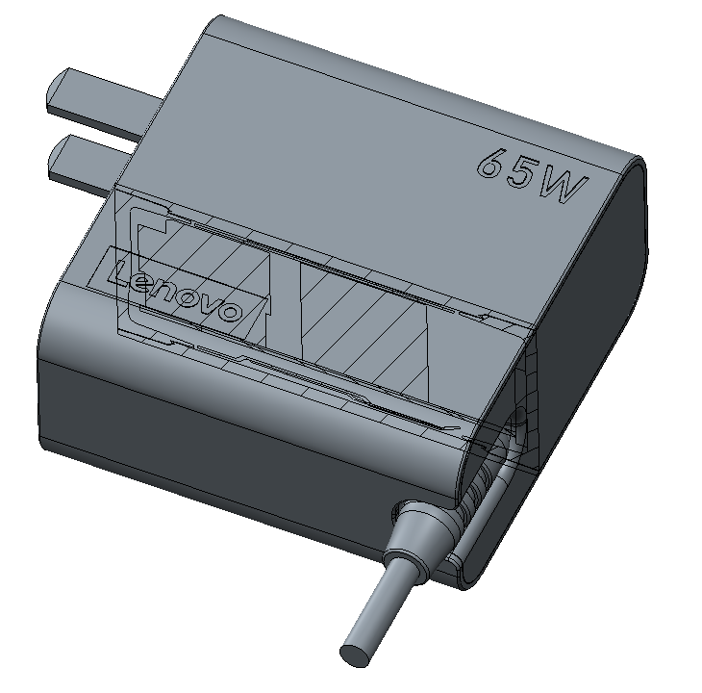
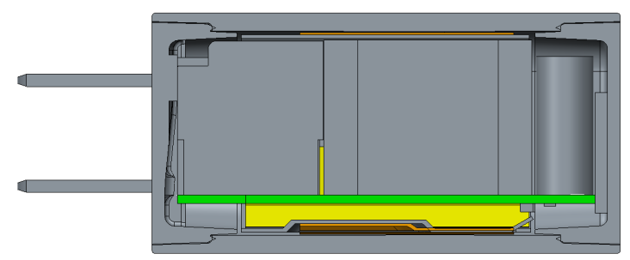
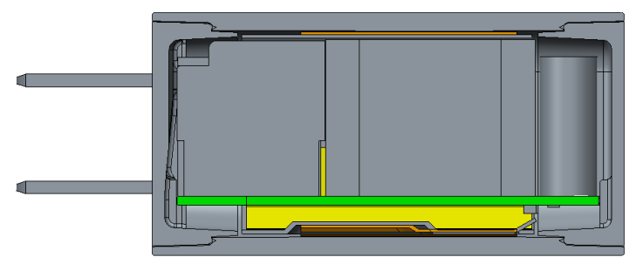
˙Root-Cause Analysis
經分析，聲音來源為因變壓器的高頻震動所引起的PCB震動。
˙Corrective Action
上下蓋新增RIB來固定PCB，避免PCB震動。
Pad
Pad
Rib
Rib
View
Before
After

Slide 6
˙Improve Sample Verification
改善對策導入後，在相同頻段可獲得明顯改善
Output | Load Change | 90V/50Hz |  |  |  | 115V/50Hz |  |  |  | 230V/60Hz |  |  |  | 265V/60Hz
 |  | Total | 8kHz | 10kHz | 12.5kHz | Total | 8kHz | 10kHz | 12.5kHz | Total | 8kHz | 10kHz | 12.5kHz | Total | 8kHz | 10kHz | 12.5kHz
+5V mode 1KHz | 0 to 0.75A | 10.6 | 2.0 | -3.7 | -5.7 | 7.9 | -1.5 | -6.1 | -8.3 | 10.1 | 0.1 | -4.0 | -6.7 | 9.0 | 0.5 | -4.5 | -6.9
 | 0.75 to 1.5A | 10.9 | 1.1 | -6.0 | -7.8 | 10.8 | 1.2 | -6.2 | -7.9 | 14.6 | 3.0 | -4.2 | -5.9 | 13.2 | 3.3 | -2.5 | -5.6
 | 1.5 to 2.25A | 8.2 | -3.1 | -6.9 | -8.5 | 8.7 | -1.5 | -6.7 | -8.6 | 11.4 | 2.8 | -4.0 | -8.2 | 11.5 | 3.5 | 0.2 | -5.8
 | 2.25 to 3A | 7.4 | -4.0 | -6.3 | -8.5 | 7.9 | -2.9 | -5.3 | -8.4 | 8.4 | -2.3 | -6.2 | -8.7 | 7.4 | -3.8 | -6.6 | -8.6
 | 3 to 2.25A | 7.4 | -4.0 | -6.3 | -8.4 | 7.9 | -2.9 | -5.4 | -8.4 | 8.3 | -2.3 | -6.2 | -8.7 | 7.5 | -3.8 | -6.6 | -8.7
 | 2.25 to 1.5A | 8.2 | -3.1 | -6.8 | -8.5 | 8.6 | -1.6 | -6.8 | -8.5 | 11.4 | 2.9 | -4.1 | -8.1 | 11.4 | 3.7 | -0.1 | -5.8
 | 1.5 to 0.75A | 9.3 | -0.4 | -6.4 | -8.2 | 11.1 | 1.8 | -6.3 | -7.9 | 14.5 | 3.9 | -4.2 | -6.1 | 13.6 | 3.3 | -3.1 | -5.4
 | 0.75 to 0A | 8.9 | -2.8 | -6.3 | -8.5 | 7.7 | -1.6 | -6.5 | -8.4 | 9.8 | -0.3 | -4.9 | -6.9 | 8.7 | 0.6 | -5.3 | -7.0
+9V mode 1KHz | 0 to 1A | 13.0 | 3.8 | 1.0 | -2.2 | 13.8 | 3.1 | -0.3 | -5.5 | 13.6 | 2.9 | 2.1 | -2.6 | 13.6 | 3.7 | 1.1 | -2.4
 | 1 to 2A | 12.8 | 2.9 | -1.2 | -3.4 | 12.2 | 2.6 | -1.6 | -3.7 | 13.9 | 2.6 | -2.6 | 0.3 | 13.0 | 2.1 | 3.8 | 0.1
 | 2 to 3A | 13.8 | 0.5 | -2.9 | -6.7 | 11.6 | 3.1 | -3.8 | -4.8 | 11.6 | 2.2 | 0.2 | -2.1 | 11.8 | 2.2 | 1.6 | -1.9
+15V mode 1KHz | 0 to 1A | 13.8 | -3.8 | -1.2 | -1.9 | 13.3 | 0.9 | -4.8 | -4.6 | 13.9 | -4.3 | -1.7 | -4.0 | 13.6 | -2.8 | -1.3 | -4.8
 | 1 to 2A | 13.4 | 0.7 | -3.4 | -3.2 | 14.0 | -3.0 | -1.8 | -4.5 | 13.5 | -2.4 | -3.5 | -1.8 | 13.3 | -2.1 | -0.4 | 0.6
 | 2 to 3A | 13.8 | 0.1 | -3.5 | -5.0 | 13.6 | -4.0 | -1.2 | -4.7 | 13.0 | -1.9 | -3.9 | -8.2 | 13.7 | -0.5 | -4.1 | -8.0
+20V mode 1KHz | 0 to 1A | 13.4 | -1.4 | -5.0 | -5.7 | 13.7 | -2.1 | -4.2 | -5.3 | 14.4 | -0.4 | -5.2 | -3.9 | 14.0 | 3.9 | -4.3 | -1.2
 | 1 to 2A | 11.3 | -2.2 | -5.6 | -7.0 | 12.3 | -1.7 | -4.7 | -7.0 | 13.7 | 0.2 | -4.7 | -5.1 | 14.7 | 0.7 | -3.2 | -1.8
 | 2 to 3.25A | 14.2 | 1.2 | -1.6 | -4.0 | 13.6 | 0.7 | -2.5 | -4.3 | 13.8 | -0.7 | -5.5 | -7.5 | 14.0 | 0.5 | -4.7 | -7.7

Slide 7
˙ Preventive Action :
RMA噪音反饋集中於輕載條件，原因為因變壓器的高頻震動所引起的PCB震動
筒狀結構的適配器於上下蓋增加 RIB 以固定住PCB 可改善此問題

